Slide 1


Snowflake Architecture
Authentication & Access Control
The Cloud services layer provides the necessary management and coordination for Snowflake's overall functionality. It includes various services such as query optimization, metadata management, access control, security, and resource management. These services ensure the efficient execution of queries, data governance, and security of the Snowflake environment.
Cloud Services
Infrastructure Manager
Optimizer
Metadata Manager
Security
The compute layer in Snowflake handles all the processing power required for executing queries and performing data transformations. It operates independently of the storage layer and can scale dynamically based on the workload demands. This separation allows users to scale compute resources up or down without impacting the underlying data.
Virtual Warehouse
Virtual Warehouse
Query Processing
Snowflake's storage layer is responsible for storing all data in a highly efficient and compressed manner. It uses a unique data storage format called Micro-partitions, which are immutable and contain a small amount of data. This enables efficient data retrieval and minimizes the amount of data accessed during queries.
Database Storage

Slide 2

Snowflake DDL -
DDL commands are used to create, manipulate, and modify objects in Snowflake, such as users, virtual warehouses, databases, schemas, tables, views, columns, functions, and stored procedures.
They are also used to perform many account-level and session operations, such as setting parameters, initializing variables, and initiating transactions.
The following commands serve as the base for all DDL commands:
ALTER <object>
COMMENT
CREATE <object>
DESCRIBE <object>
DROP <object>
SHOW <objects>
USE <object>
Refer Session2-DDL for examples
Each command takes an object type and identifier, as well as additional parameters and options. The descriptions for the individual commands provide the syntax and full list of parameters that can be specified for each command. The descriptions also provide detailed usage notes and examples.

Slide 3
Working with Roles:
In Snowflake, roles and privileges are used to control access to the various objects and resources within a Snowflake data warehouse. They allow you to define the level of access and permissions that users have on databases, schemas, tables, views, and other objects.
Roles: A role is a named collection of privileges. It represents a group of users or other roles. Roles can be assigned to users or other roles, allowing them to inherit the privileges associated with the role. Roles can be hierarchical, where roles at higher levels inherit the privileges of roles at lower levels.
Privileges: Privileges define the specific actions that a user or role can perform on objects within Snowflake. Some common privileges include SELECT, INSERT, UPDATE, DELETE, and CREATE. Privileges can be granted at different levels, such as global, database, schema, table, or view level.
The privileges that can be granted are object-specific and are grouped into following categories:
-- Global privileges
-- privileges for account objects (resource monitors, virtual warehouse & databases.)

Slide 4
Different Roles in Snowflake:
Custom account roles can be created using the USERADMIN role (or a higher role) as well as by any role to which the CREATE ROLE privilege has been granted.
Custom database roles can be created by the database owner (i.e. the role that has the OWNERSHIP privilege on the database).
By default, a newly-created role is not assigned to any user, nor granted to any other role.
ACCOUNTADMIN (account administrator) Top Level Role in the system and should be granted only to limited/controlled number of users in account.
SECURITYADMIN (security administrator)
Role that can monitor and manage users and roles. More specifically this role is used to: a) Modify and monitor any user, role or session.
b) Modify any grants, including revoking it.
USERADMIN (user and role administrator) Role that can create users and roles. More specifically this role is used to create users and roles in your account, and grant privileges to those roles.
SYSADMIN (system administrator) This role has privileges to create warehouse and databases (and other objects) in an account. Also grant privileges on warehouse, databases and other objects to other roles.
PUBLIC (default role assigned to every user)
Typically used in cases where explicit access control is not needed and all users are viewed as equal, with regard to their access rights.

Slide 5
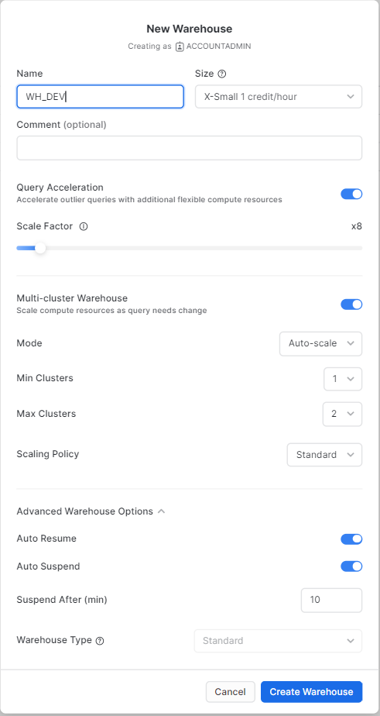
Creating a Virtual Warehouse
Size: You can specify the size of the virtual warehouse, which determines the amount of compute resources allocated to it. Snowflake offers a range of predefined sizes, from X-Small to 4X-Large, with varying levels of CPU and memory resources.
The scaling policy : Determines how Snowflake adjusts the size of the virtual warehouse based on the workload. It consists of two primary components:
a. Minimum Cluster Count: You can set a minimum number of compute clusters that should be always available. This ensures a baseline level of compute resources for consistent performance.
b. Auto-scale Policy: Snowflake offers two options for auto-scaling:
Standard Scaling Policy: This policy is designed for workloads that require consistent and predictable performance. With the standard policy, Snowflake automatically scales the virtual warehouse up or down based on the workload demand and query concurrency. It monitors the query queue time and adjusts the number of compute clusters dynamically to efficiently handle the workload.
Economy Scaling Policy: The economy policy is specifically designed for cost optimization. It aims to minimize costs by reducing the number of compute clusters during periods of low workload. When the workload decreases, Snowflake scales down the virtual warehouse to allocate fewer resources and save costs. However, it's important to note that the economy policy may result in slightly longer query queue times during peak workload periods. In both policies, Snowflake can scale up the warehouse size to accommodate increased demand or scale down when the workload decreases.

Slide 6
..Scaling policy comparison
Policy | Description | Warehouse Starts… | Cluster Shuts Down…
Standard (default) | Prevents/minimizes queuing by favoring starting additional clusters over conserving credits. | The first cluster starts immediately when either a query is queued or the system detects that there’s one more query than the currently-running clusters can execute. Each successive cluster waits to start 20 seconds after the prior one has started. For example, if your warehouse is configured with 10 max clusters, it can take a full 200+ seconds to start all 10 clusters. | After 2 to 3 consecutive successful checks (performed at 1 minute intervals), which determine whether the load on the least-loaded cluster could be redistributed to the other clusters without spinning up the cluster again.
Economy | Conserves credits by favoring keeping running clusters fully-loaded rather than starting additional clusters, which may result in queries being queued and taking longer to complete. | Only if the system estimates there’s enough query load to keep the cluster busy for at least 6 minutes. | After 5 to 6 consecutive successful checks (performed at 1 minute intervals), which determine whether the load on the least-loaded cluster could be redistributed to the other clusters without spinning up the cluster again.

Slide 7
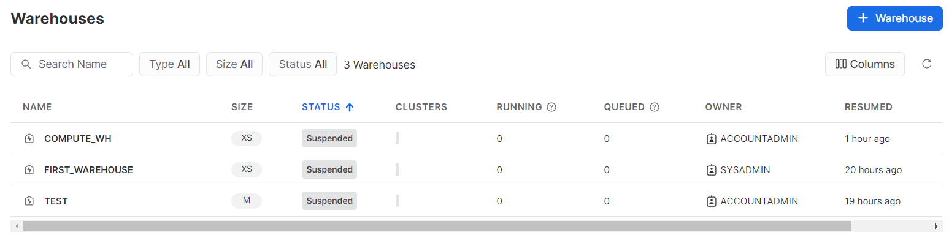
Auto Suspended Warehouses

Slide 8
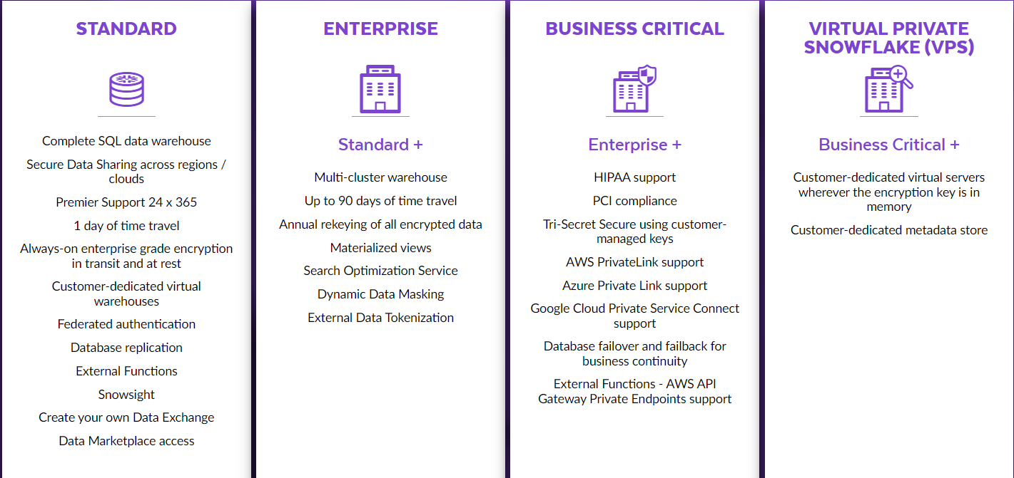
Snowflake editions

